Slide 1
Embodied AI · Week 27
Video to R1:
the GVHMR stage
video → GVHMR → human kinematics → GMR → R1 joint trajectories → imitation learning
The first half of that pipeline is now closed on my laptop, and this deck is how.
Shaoqin Li · CCNY · Prof. Yi Sun · September 2026

Slide 2
Where week 26 left it
Retargeting was validated. The stage in front of it — getting human motion out of a video — did not exist yet.
What I had
What I did not have
This week
GMR retargets human motion onto the R1 with an IK config for every format it supports. Three formats had actually been run end to end (Xsens BVH, LAFAN1 BVH, SMPL-X from OMOMO), each with 0 joint-limit violations and real-time IK. On three of four plausibility measures the R1 matched the G1.
A way to get SMPL-X out of a phone video. Every motion so far came from a mocap dataset. The goal is to film a person, retarget that onto the R1, and train the R1 to do it. Without a perception stage the goal has no input.
I installed GVHMR (the video → SMPL-X model) on this laptop, ran it on a clip, joined its output to GMR, retargeted the result onto the R1, and found and fixed the one thing in the output that would have poisoned imitation learning.
Everything in this deck ran on the GTX 1650 laptop. Every terminal panel is captured stdout.

Slide 3
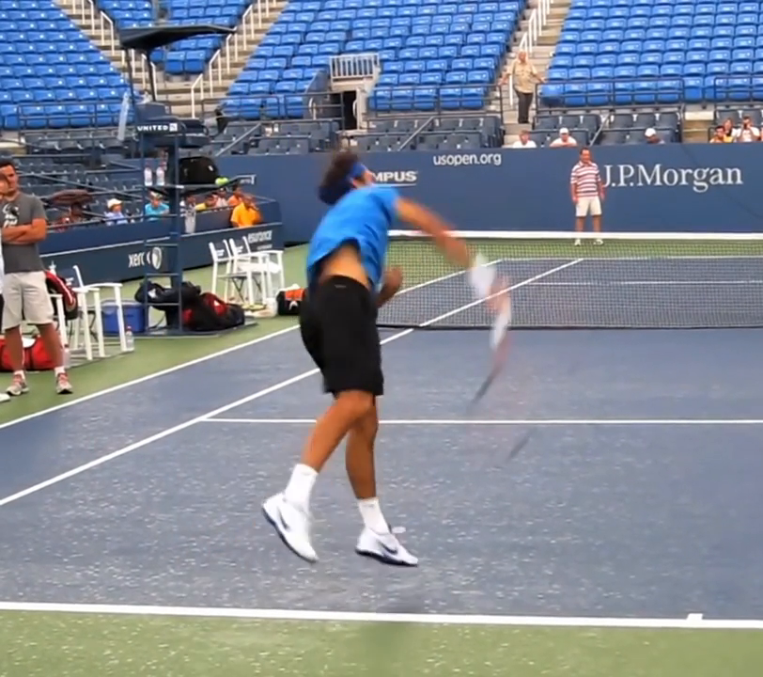
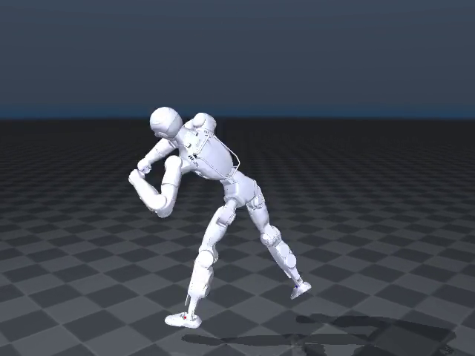
The pipeline, and where each stage stands
Each arrow is a file. What one stage writes is exactly what the next one reads.
Video
.mp4
(a phone, 30 fps)
GVHMR
video →
SMPL-X
Human
kinematics
hmr4d_results.pt
(SMPL-X per frame)
GMR
SMPL-X →
R1 IK
R1 joint
trajectories
motion .pkl
(qpos @ 30 fps)
Imitation
learning
RL tracks the
reference
R1 in the
simulator
the same
motion
DONE
DONE · this week
DONE · this week
DONE · wk 24–26
DONE · this week
NOT STARTED
NOT STARTED
What that looks like on the one clip I have run:
Next: an RL policy that tracks this .pkl while balancing. That is a lab-GPU job and the format is the one TWIST / BeyondMimic / ASAP consume.
GVHMR's demo clip, tennis.mp4 (10.4 s)
the R1, 312 frames later

Slide 4
Part 1
The paper
GVHMR — World-Grounded Human Motion Recovery via Gravity-View Coordinates
Shen, Pi, Xia, Cen, Peng, Hu, Bao, Hu, Zhou · Zhejiang University · SIGGRAPH Asia 2024 · arXiv 2409.06662

Slide 5
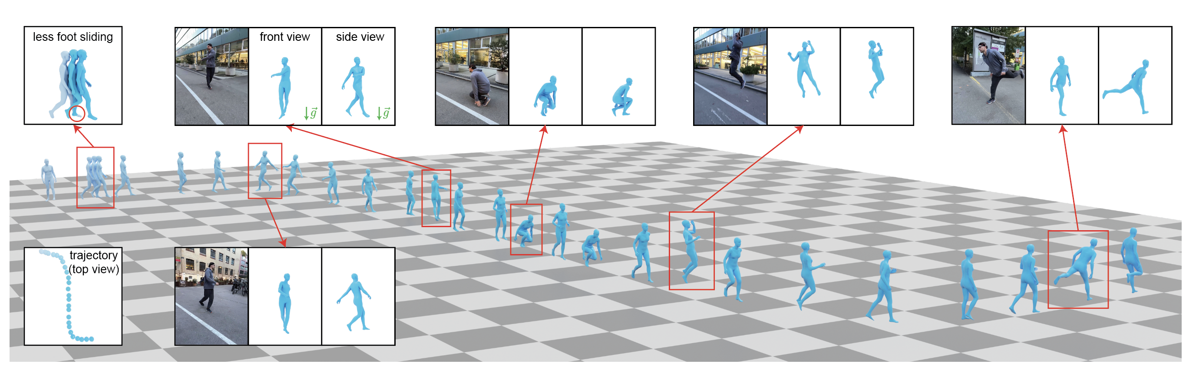
The problem it solves: where is the person in the world?
Camera-space pose from a single frame is a solved problem. Putting a whole clip into one gravity-aligned world is not.
Their teaser: one monocular video in, a person moving through a world with a floor and gravity out.
Easy: the camera frame
Hard: the world frame
Their answer
Models like HMR2 already read one frame and give a body pose relative to the camera. That is what our image features come from.
"World" is ambiguous — every clip has its own. The old answer (WHAM) predicts how the person moved since the last frame and adds it up. Small errors add up too, and the trajectory drifts.
Do not predict in the world frame. Predict each frame in a frame that is defined the same way every time — by gravity and by where the camera looks — then rotate it into the world.

Slide 6
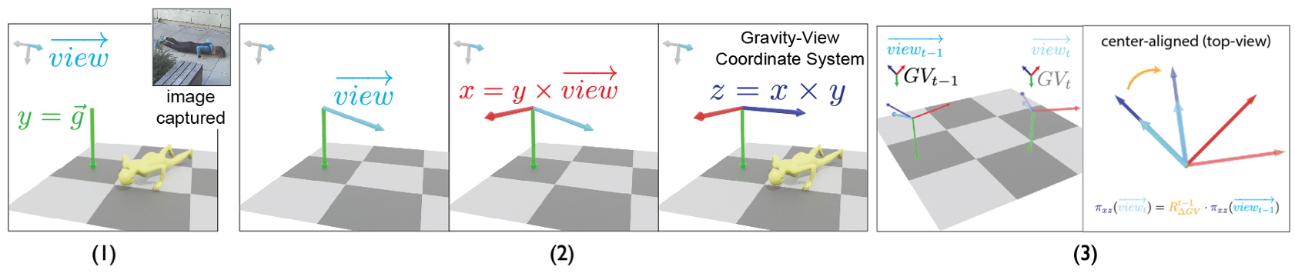
The idea: Gravity-View coordinates
A frame that exists for every video frame and never has to be guessed.
Figure from the paper: gravity gives the vertical axis, the camera's view direction gives the horizontal one.
How it is built, per frame
Why that beats adding up steps
Up is gravity. Forward is the camera's viewing direction, flattened onto the ground. That is enough to fix a full coordinate frame — and it is the same recipe in every frame of every clip, so the network learns one consistent mapping from image to pose.
Each frame's pose is estimated on its own and then rotated into the world using the camera's rotation. Nothing is accumulated, so nothing drifts — in orientation. Translation is still integrated from a predicted root velocity, and that is where the drift I found later lives.

Slide 7
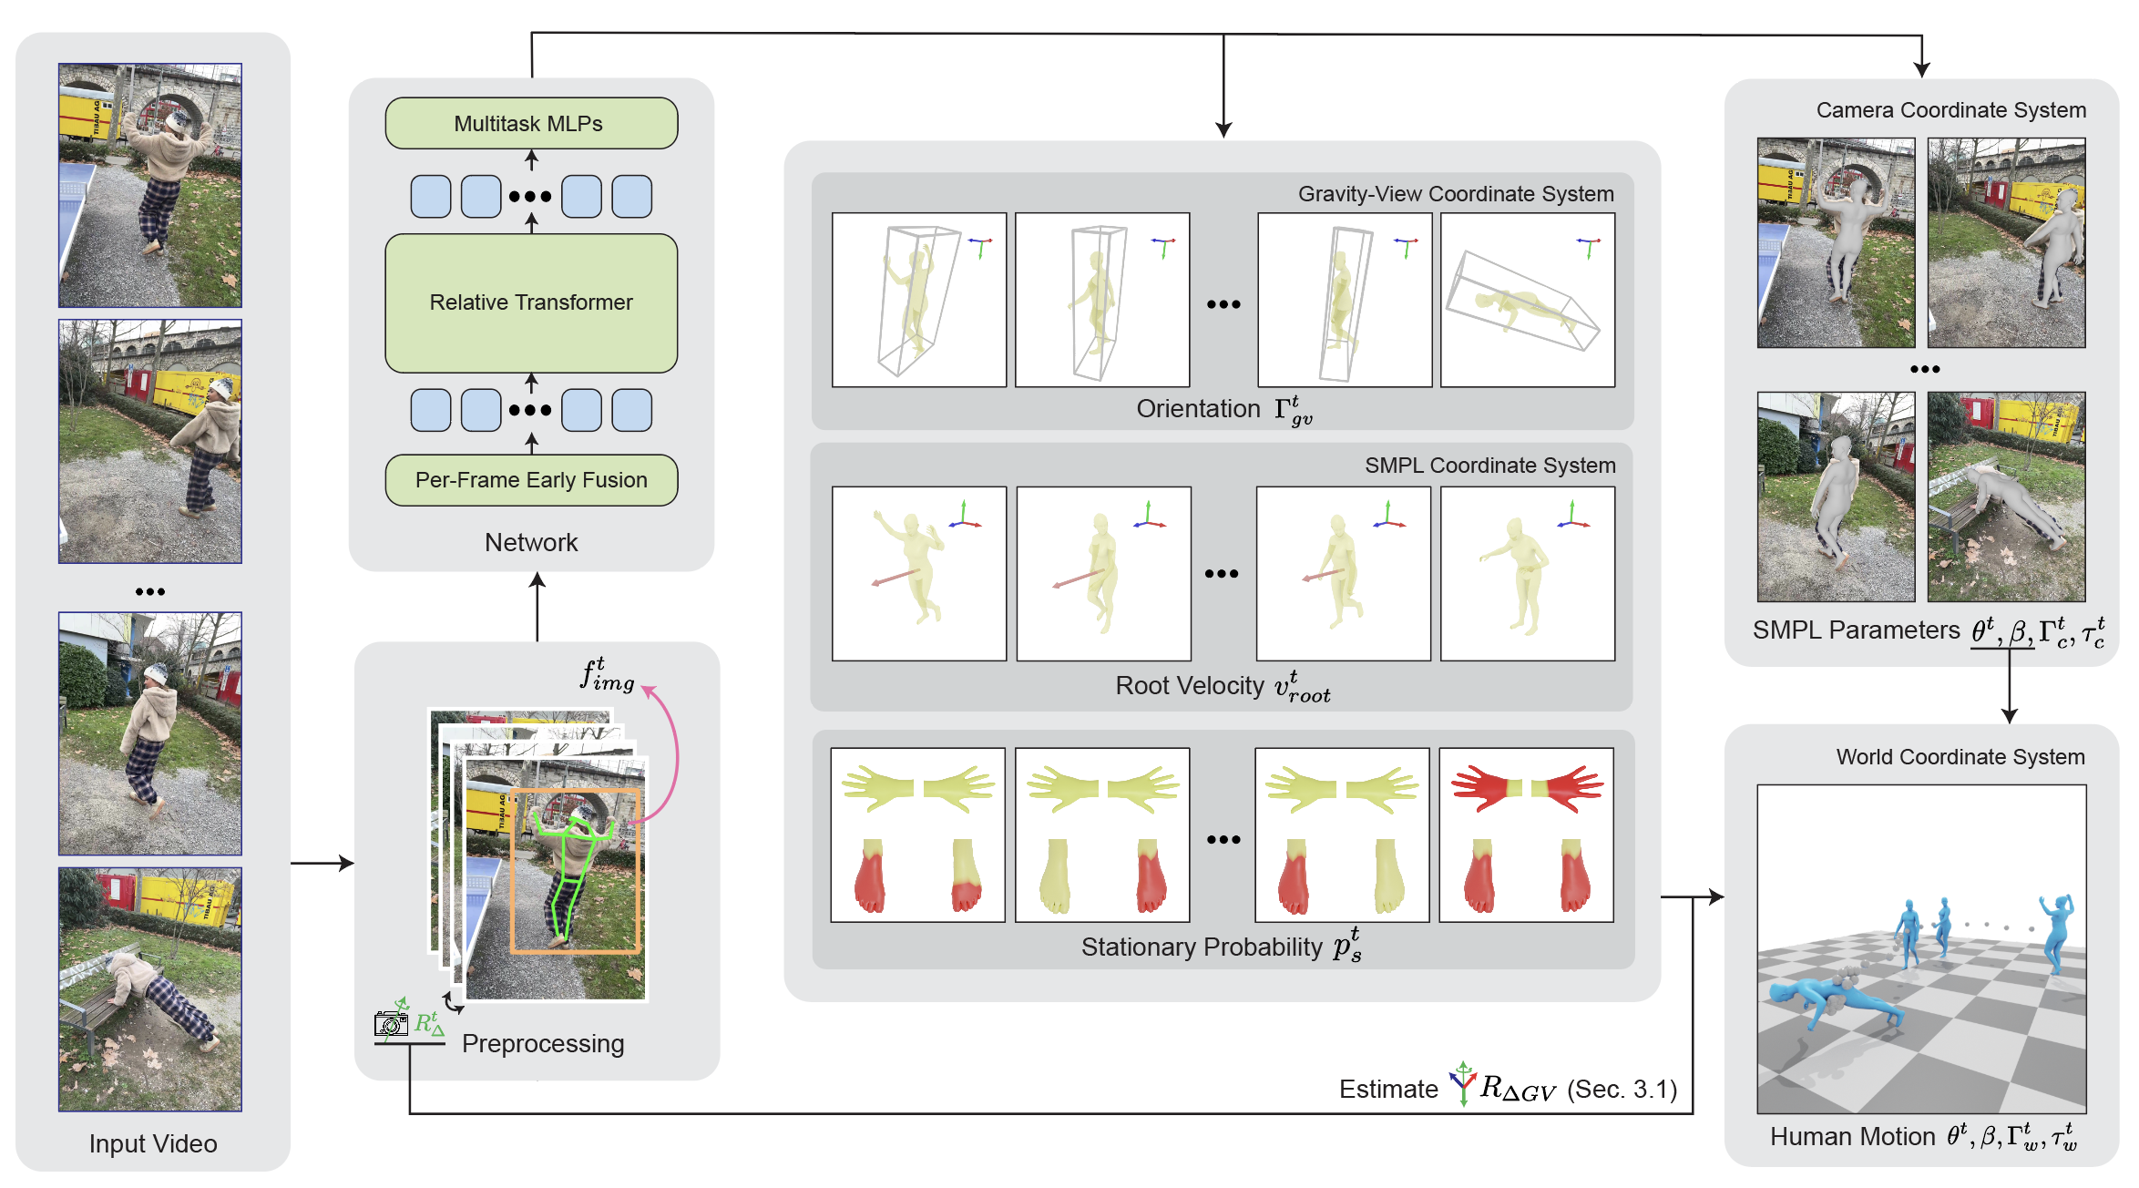
The architecture
Their pipeline figure, and what actually goes in and comes out.
In: four things per frame
A person box from YOLOv8 · 2D keypoints from ViTPose · image features from HMR2's frozen encoder · the camera rotation, from visual odometry (DPVO) — or, with the -s flag I use, assumed static.
The network
A 12-layer transformer encoder, 8 heads, width 512, rotary position encoding. The whole clip goes in at once, not frame by frame; at inference each frame attends ±120 neighbours.
Out: per frame
SMPL-X body pose and shape · the body's orientation in Gravity-View coordinates · a root velocity · and a "stationary" probability for hands, toes and heels. Velocity is integrated into a world trajectory; the stationary joints are then used to pull sliding feet back into place.

Slide 8
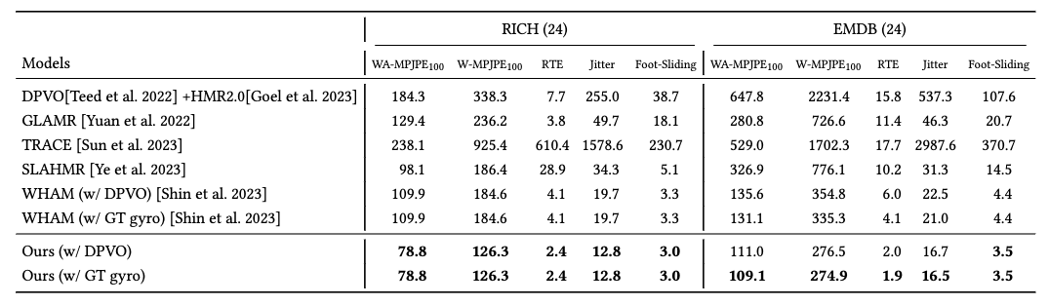
What they measured
World-grounded accuracy on in-the-wild benchmarks, against WHAM — the previous best.
The headline row (EMDB)
Joint error over 100-frame windows: 274.9 mm vs WHAM's 335.3 mm.
Trajectory error: 1.9 % vs 4.1 %.
Jitter: 16.5 vs 21.0.
In camera space (3DPW) the two are a wash — 36.2 vs 35.9 mm. The gain is all in the world frame, which is the frame a robot lives in.
Table 1 of the paper (EMDB and RICH, world-grounded metrics).
Cost
Why it is the right stage for us
Trained on AMASS, BEDLAM, H36M and 3DPW: 420 epochs, 13 hours on two RTX 4090s. Inference: 280 ms for a 45-second clip on one 4090 — the transformer is cheap; the detectors in front of it are not.
It writes SMPL-X parameters. GMR already reads SMPL-X — the same smplx_to_r1.json that ran OMOMO in week 26. So the join needs no new retargeting config, only a loader.

Slide 9
Part 2
The repo
github.com/zju3dv/GVHMR — what is inside, and what it needs
Cloned at commit ee960bb (2026-09-15). Everything on the next three slides is the real tree and the real file sizes.

Slide 10
What is in the repo
The folders that matter for running it, from the actual clone.
~/GVHMR — the folders that matter, ls -C
hmr4d/
$ cd ~/GVHMR && ls -C -w 62 -I '*.egg-info'
LICENSE hmr4d pyproject.toml setup.py
README.md inputs pyrightconfig.json third-party
docs outputs requirements.txt tools
$ ls -C -w 62 -I __pycache__ hmr4d hmr4d/network hmr4d/utils/preproc
hmr4d:
__init__.py configs dataset network
build_gvhmr.py datamodule model utils
hmr4d/network:
base_arch gvhmr hmr2
hmr4d/utils/preproc:
__init__.py tracker.py vitpose_pytorch
relpose vitfeat_extractor.py
slam.py vitpose.py
$ ls -C -w 62 tools/demo inputs/checkpoints
inputs/checkpoints:
body_models dpvo hmr2 vitpose
checkpoints gvhmr ids.txt yolo
tools/demo:
colab_demo.ipynb demo.py demo_folder.py
The model. network/ holds the transformer and the HMR2 encoder; utils/preproc/ holds YOLO, ViTPose and the feature extractor; configs/ is Hydra.
tools/demo/demo.py
The one entry point I use: video in, hmr4d_results.pt out.
inputs/checkpoints/
Empty after the clone. Five weight files and the body models go here — you fetch them.
third-party/DPVO
Optional camera odometry for moving cameras. Skipped — I hold the phone still and pass -s.

Slide 11
The spec: what it needs to run
5.5 GB of weights, a pinned environment, and a 4 GB card that turned out to be enough.
the weights, as downloaded
Two of the five are huge
$ find inputs/checkpoints -type f | xargs ls -lh | awk '{print $5, $9}'
104M inputs/checkpoints/body_models/smplx/SMPLX_FEMALE.npz
104M inputs/checkpoints/body_models/smplx/SMPLX_MALE.npz
104M inputs/checkpoints/body_models/smplx/SMPLX_NEUTRAL.npz
14M inputs/checkpoints/dpvo/dpvo.pth
156M inputs/checkpoints/gvhmr/gvhmr_siga24_release.ckpt
2.6G inputs/checkpoints/hmr2/epoch=10-step=25000.ckpt
295 inputs/checkpoints/ids.txt
2.4G inputs/checkpoints/vitpose/vitpose-h-multi-coco.pth
131M inputs/checkpoints/yolo/yolov8x.pt
$ du -sh inputs/checkpoints
5.5G inputs/checkpoints
ViTPose-H (2.4 GB) and the HMR2 backbone (2.6 GB) are both ViT-Huge. GVHMR's own transformer is 156 MB. Those two big files are the whole story of the setup section.
Hardware
the environment, as it is
$ conda env list | grep gvhmr
gvhmr /home/sql/miniconda3/envs/gvhmr
$ conda activate gvhmr && python -c 'import torch, pytorch3d, lightning, ultralytics, setuptools; print(torch.__version__, torch.cuda.is_available(), torch.cuda.get_device_name(0)); print("pytorch3d", pytorch3d.__version__, "lightning", lightning.__version__, "ultralytics", ultralytics.__version__, "setuptools", setuptools.__version__)'
2.3.0+cu121 True NVIDIA GeForce GTX 1650
pytorch3d 0.7.6 lightning 2.3.0 ultralytics 8.2.42 setuptools 69.5.1
The paper used RTX 4090s. This laptop has a GTX 1650 with 4 GB of VRAM and a WSL RAM cap of 5.9 GB. Peak VRAM on the run was 3.9 GB — about 170 MB to spare.

Slide 12
What one run produces
One file. This is the hand-off to GMR.
outputs/demo/tennis/hmr4d_results.pt
Reading it
$ python -c "import torch; d=torch.load('outputs/demo/tennis/hmr4d_results.pt'); print(list(d)); g=d['smpl_params_global']; [print(k, tuple(v.shape)) for k,v in g.items()]; print('K_fullimg', tuple(d['K_fullimg'].shape))"
['smpl_params_global', 'smpl_params_incam', 'K_fullimg', 'net_outputs']
body_pose (312, 63)
betas (312, 10)
global_orient (312, 3)
transl (312, 3)
K_fullimg (312, 3, 3)
$ ls -la outputs/demo/tennis/
total 3128
drwxr-xr-x 3 sql sql 4096 Sep 16 17:57 .
drwxr-xr-x 3 sql sql 4096 Sep 16 17:50 ..
-rw-r--r-- 1 sql sql 1826234 Sep 16 17:50 0_input_video.mp4
-rw-r--r-- 1 sql sql 1361727 Sep 16 17:57 hmr4d_results.pt
drwxr-xr-x 2 sql sql 4096 Sep 16 17:57 preprocess
312 frames — the clip, re-encoded to 30 fps.
body_pose 63 = 21 joints × 3 rotation numbers.
betas 10 = body shape.
global_orient + transl = where the pelvis is and faces, in the world (_global) or relative to the camera (_incam).
K_fullimg = the camera intrinsics it assumed.
The one convention to know
GVHMR's world is y-up. GMR's is z-up. GMR's own loader for this file already applies the rotation, so nothing had to be written for it — I checked by reading pelvis (≈1.0 m) and head (≈1.6 m) heights after loading.

Slide 13
Part 3
Setting it up — honestly
Five steps, three of which did not go the way the README says
Clone and env · weights · first run and the wall · the change · the run that worked

Slide 14
Step 1 — clone and build the environment
The README is three lines. Three packages needed a pin it does not mention.
the README's three lines, then the check
What bit
$ git clone https://github.com/zju3dv/GVHMR && cd GVHMR
$ conda create -y -n gvhmr python=3.10 && conda activate gvhmr
$ pip install -r requirements.txt && pip install -e .
# what it left me with:
$ conda env list | grep gvhmr
gvhmr /home/sql/miniconda3/envs/gvhmr
$ conda activate gvhmr && python -c 'import torch, pytorch3d, lightning, ultralytics, setuptools; print(torch.__version__, torch.cuda.is_available(), torch.cuda.get_device_name(0)); print("pytorch3d", pytorch3d.__version__, "lightning", lightning.__version__, "ultralytics", ultralytics.__version__, "setuptools", setuptools.__version__)'
2.3.0+cu121 True NVIDIA GeForce GTX 1650
pytorch3d 0.7.6 lightning 2.3.0 ultralytics 8.2.42 setuptools 69.5.1
setuptools had to be pinned below 70 — lightning still imports pkg_resources.
chumpy only builds with --no-build-isolation.
pytorch3d 0.7.6 came from a prebuilt wheel, not source.
jupyter, ipdb and black I skipped; they are dev tools.
Stack that ended up working: torch 2.3.0+cu121 · pytorch3d 0.7.6 · lightning 2.3.0 · ultralytics 8.2.42 · setuptools 69.5.1

Slide 15
Step 2 — the weights
The README points at Google Drive. Google Drive would not give me the two big files.
after the downloads
What happened
$ find inputs/checkpoints -type f | xargs ls -lh | awk '{print $5, $9}'
104M inputs/checkpoints/body_models/smplx/SMPLX_FEMALE.npz
104M inputs/checkpoints/body_models/smplx/SMPLX_MALE.npz
104M inputs/checkpoints/body_models/smplx/SMPLX_NEUTRAL.npz
14M inputs/checkpoints/dpvo/dpvo.pth
156M inputs/checkpoints/gvhmr/gvhmr_siga24_release.ckpt
2.6G inputs/checkpoints/hmr2/epoch=10-step=25000.ckpt
295 inputs/checkpoints/ids.txt
2.4G inputs/checkpoints/vitpose/vitpose-h-multi-coco.pth
131M inputs/checkpoints/yolo/yolov8x.pt
$ du -sh inputs/checkpoints
5.5G inputs/checkpoints
Drive returned "quota exceeded" on the 2.4 GB and 2.6 GB files. A HuggingFace mirror (camenduru/GVHMR) has the identical files under the same paths, so I pulled from there and checked each size against the server's own header. curl over HTTP/2 truncated twice; --http1.1 with resume did not.
Body models
DPVO
SMPL-X is registration-gated. I already had the .npz trio from the GMR work, so I copied them in. The SMPL .pkl the README also asks for I never got — see step 5 for what that costs.
14 MB, downloaded for completeness, never loaded: -s skips it. If the phone moves during a clip this becomes required and needs its own compiled install.

Slide 16
Step 3 — the first run hit a wall, and it was not the GPU
Stock code, tennis.mp4: five and a half minutes to load one model, GPU idle the whole time.
What I saw
What was actually happening
ViTPose took 343 s to load before it processed a single frame. nvidia-smi showed the card empty. The laptop was swapping. My first guess — 4 GB of VRAM is too small — was wrong: peak VRAM was 3.9 GB and the run never ran out.
torch.load reads the 2.4 GB checkpoint fully into RAM. Then the model is constructed on the CPU — a second 2.4 GB copy — and only then moved to the GPU. Two copies of a ViT-Huge inside a 5.9 GB RAM cap is a swap storm.
The lesson I took from it
On a big workstation this code path is invisible — 16 GB of RAM absorbs both copies. On a laptop it is the whole wall. So the question was never "can the 1650 run GVHMR"; it was "can I keep two copies of a huge model out of RAM". The answer is a memory-map and a device context, and nothing about the model changes.

Slide 17
Step 4 — the change: 3 files, 16 lines, and it is only about memory
This is the real diff. The other two files are the same two edits.
git diff --stat, then the hmr2 hunk
Edit 1: mmap=True
$ git diff --stat
hmr4d/model/gvhmr/gvhmr_pl_demo.py | 2 +-
hmr4d/network/hmr2/__init__.py | 8 ++++++--
.../preproc/vitpose_pytorch/src/vitpose_infer/model_builder.py | 10 +++++++++-
3 files changed, 16 insertions(+), 4 deletions(-)
diff --git a/hmr4d/network/hmr2/__init__.py b/hmr4d/network/hmr2/__init__.py
index 4be998b..34db657 100644
--- a/hmr4d/network/hmr2/__init__.py
+++ b/hmr4d/network/hmr2/__init__.py
@@ -22,9 +22,13 @@ def load_hmr2(checkpoint_path=HMR2A_CKPT):
# Setup model and Load weights.
# model = HMR2.load_from_checkpoint(checkpoint_path, strict=False, cfg=model_cfg)
- model = HMR2(model_cfg)
+ # Build directly on the GPU when available: on low-RAM hosts a CPU-side copy
+ # of the ViT-H backbone next to the mmapped checkpoint thrashes the page cache.
+ build_device = torch.device("cuda" if torch.cuda.is_available() else "cpu")
+ with torch.device(build_device):
+ model = HMR2(model_cfg)
- state_dict = torch.load(checkpoint_path, map_location="cpu")["state_dict"]
+ state_dict = torch.load(checkpoint_path, map_location="cpu", mmap=True)["state_dict"] # mmap: avoid a full RAM copy on low-RAM hosts
keys = [k for k in state_dict.keys() if k.split(".")[0] in ["backbone", "smpl_head"]]
state_dict = {k: v for k, v in state_dict.items() if k in keys}
model.load_state_dict(state_dict, strict=True)
The checkpoint is memory-mapped instead of read into RAM. Pages come in as the weights are copied to the GPU and go straight back out.
Edit 2: build on the GPU
with torch.device("cuda") makes the model's tensors land on the card as they are created. No CPU copy ever exists.
ViTPose load: 343 s → 14 s warm, ~70 s cold.

Slide 18
After the copy: what changed, what did not
The honest answer to "did you modify GVHMR" is: not the model, not the method, not the output.
STAYED STOCK
CHANGED
The weights — every checkpoint is the authors' file, byte for byte
The network — transformer, HMR2 encoder, ViTPose, YOLO: untouched
The demo script and the preprocessing order
The output — hmr4d_results.pt has the same keys and shapes
The y-up world convention and the 30 fps re-encode
The -s static-camera path
How three checkpoints are read into memory (mmap) and where two models are constructed (GPU, not CPU).
That is all. 16 lines, in 3 files, all inside loaders.
It exists because of this laptop's 5.9 GB RAM cap. On a 16 GB machine stock GVHMR runs as-is, and the patch is harmless there — mmap and a device context cost nothing.
The patch is uncommitted in ~/GVHMR (git diff). Re-cloning loses it; I keep the diff in the package.

Slide 19
Step 5 — the run that worked, captured this evening
Fresh output folder so nothing was cached. 7 minutes 0 seconds for 10.4 seconds of video.
progress bars trimmed to their final line; nothing else edited
Where the time goes
$ conda activate gvhmr
$ cd ~/GVHMR
$ python tools/demo/demo.py --video=docs/example_video/tennis.mp4 -s --output_root outputs/week27_capture
# started 2026-09-17 21:39:58
[21:40:09][INFO] [Input]: docs/example_video/tennis.mp4
[21:40:09][INFO] (L, W, H) = (312, 812, 720)
[21:40:10][INFO] [Output Dir]: outputs/week27_capture/tennis
[21:40:10][INFO] [Copy Video] docs/example_video/tennis.mp4 -> outputs/week27_capture/tennis/0_input_video.mp4
Copy: 100%|██████████| 312/312 [00:04<00:00, 64.03it/s]
[21:40:15][INFO] [GPU]: NVIDIA GeForce GTX 1650
[21:40:15][INFO] [GPU]: _CudaDeviceProperties(name='NVIDIA GeForce GTX 1650', major=7, minor=5, total_memory=4095MB, multi_processor_count=16)
[21:40:15][INFO] [Preprocess] Start!
YoloV8 Tracking: 100%|██████████| 312/312 [00:39<00:00, 7.84it/s]
ViTPose: 100%|██████████| 20/20 [02:29<00:00, 7.47s/it]
HMR2 Feature: 100%|██████████| 20/20 [01:08<00:00, 3.42s/it]
[21:46:01][INFO] [Preprocess] End. Time elapsed: 345.41s
[21:46:01][INFO] [HMR4D] Predicting
[21:46:03][INFO] [EnDecoder] Use MM_V1_AMASS_LOCAL_BEDLAM_CAM for statistics!
[21:46:09][INFO] [PL-Trainer] Loading ckpt type: inputs/checkpoints/gvhmr/gvhmr_siga24_release.ckpt
[21:46:12][INFO] [HMR4D] Elapsed: 3.08s for data-length=10.4s
Traceback (most recent call last): [... 10 frames trimmed ...]
render_incam(cfg)
AssertionError: Path /home/sql/GVHMR/inputs/checkpoints/body_models/smpl does not exist!
# finished 2026-09-17 21:46:58
YOLO 39 s · ViTPose 2:29 · HMR2 1:08 · GVHMR itself 3.08 s.
The two ViT-Huge detectors are 95 % of it. The paper's 280 ms is the last line only.
The crash at the end is cosmetic
hmr4d_results.pt is written at 21:46:12. The traceback is the overlay renderer asking for the SMPL .pkl I never registered for. The file I need already exists.

Slide 20
Part 4
Using it — the join to GMR
hmr4d_results.pt in, an R1 motion file out, and a drift I had to fix
All numbers on the next four slides are from r1_gmr/measurements/week28_*.txt

Slide 21
Step 6 — the join: GVHMR's file into GMR, onto the R1
Same retargeting config OMOMO used. The only new code is a loader and a headless renderer.
gvhmr_to_robot_headless.py — the whole thing, listing trimmed
What is new
$ conda activate gmr && cd ~/GMR
$ python ~/claude_code_projects/embodied_ai_r1/r1_gmr/gvhmr_to_robot_headless.py --gvhmr_pred_file ~/GVHMR/outputs/demo/tennis/hmr4d_results.pt --robot unitree_r1 --ground linear --video_path r1_gmr/media/week28/gvhmr_r1_tennis_ground.mp4 --save_path r1_gmr/measurements/week28_gvhmr_tennis_r1_ground_linear.pkl
[headless] tennis/hmr4d_results.pt: 312 frames total, using [0:312] = 312 @ 30 fps, human height 1.728 m (from betas[0])
[... robot DoF and body listing, 62 lines ...]
Use IK config:
/home/sql/GMR/general_motion_retargeting/ik_configs/smplx_to_r1.json
[ground] mode=linear: linear slope +1.54 cm/s, intercept -0.012 m, envelope resid sd 1.74 cm
[ground] lowest foot joint before 0.004..0.210 m -> after 0.000..0.142 m (target 0.000)
[headless] IK solve rate: 129.5 FPS (2.4s for 312 frames), motion is 30 fps -> real-time capable
[headless] video saved to /home/sql/claude_code_projects/embodied_ai_r1/r1_gmr/media/week28/gvhmr_r1_tennis_ground.mp4
[headless] motion saved to /home/sql/claude_code_projects/embodied_ai_r1/r1_gmr/measurements/week28_gvhmr_tennis_r1_ground_linear.pkl
gvhmr_to_robot_headless.py: reads hmr4d_results.pt with GMR's own loader, runs the IK frame by frame, renders offscreen (the viewer cannot open under WSL2), writes the motion .pkl.
312 frames, 0 limit violations
The forehand is there
But
IK at 129 fps against a 30 fps clip — real-time with room. Every joint inside its range, as on every dataset so far.
Frame 240 of the render is the swing. Visually the retarget is right. That is where I was on Tuesday night.
Both robots floated +15 to +18 cm by the end of the clip. Not the retargeting — the source.

Slide 22
What I found: GVHMR's floor climbs 1.6 cm every second
Measured on the human, before any robot is involved.
lowest foot joint per second, from hmr4d_results.pt
The shape of it
$ python ~/claude_code_projects/embodied_ai_r1/r1_gmr/measure_gvhmr_drift.py ~/GVHMR/outputs/demo/tennis/hmr4d_results.pt
312 frames @ 30 fps, human height 1.728 m
frame t(s) lowest foot pelvis head
0 0.0 0.007 0.981 1.598
30 1.0 0.039 0.990 1.593
60 2.0 0.027 1.004 1.604
90 3.0 0.051 1.013 1.600
120 4.0 0.047 0.889 1.483
150 5.0 0.083 1.057 1.534
180 6.0 0.105 1.047 1.656
210 7.0 0.134 1.084 1.720
240 8.0 0.194 1.153 1.652
270 9.0 0.138 1.111 1.724
300 10.0 0.152 1.114 1.728
lowest foot joint: 0.004 .. 0.210 m
straight-line fit: +1.62 cm/s, residual sd 1.69 cm
The player's lowest foot starts 0.7 cm off the floor and ends 15 cm off it, while he is standing on the ground at both ends. A straight line fits it with 1.7 cm of scatter: it is a ramp, not noise.
Where it comes from
The paper predicts a root velocity and integrates it. Orientation cannot drift in Gravity-View coordinates; height can. Nothing in the model knows where the floor is.
Why it matters
A reference motion that floats teaches a policy to float. This had to be fixed before the .pkl goes anywhere near imitation learning.

Slide 23
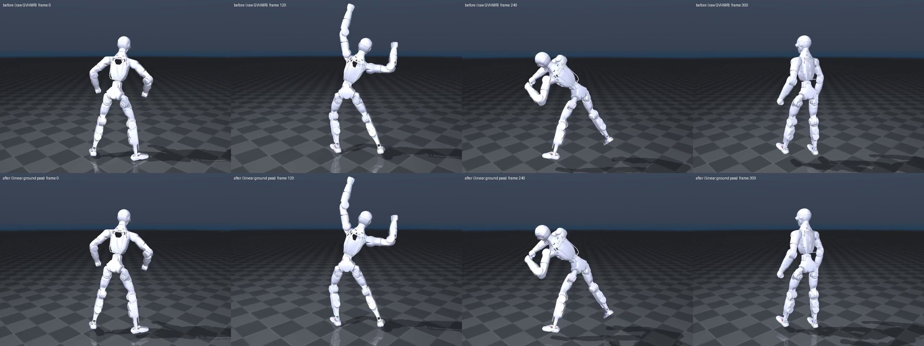
The fix: fit the ramp and take it out, before the IK
A straight-line floor per clip. GMR's built-in per-frame version was tried and rejected.
What linear does
Take the lowest foot joint per frame, its rolling minimum, fit a line, subtract it, put the clip's lowest point on the floor. Drift 1.28 → 0.04 cm/s. Limits, speed — byte-identical.
top: raw GVHMR · bottom: after the ground pass · frames 0, 120, 240, 300 — look at the feet on the right
Why not GMR's built-in
week28_ground_pass.txt — same 312 frames, same checker
offset_to_ground re-zeroes every frame: 0 % contact looks perfect, but the pelvis range drops from 22.6 to 12.7 cm — it deleted the crouch and the swing. A reference that cannot crouch is worse than one that floats.
mode drift 1st s last s mean contact pelvis
none +1.28 -0.67 +11.48 +5.65 13.1 % 22.6 cm <- Tuesday
const +1.28 -1.01 +11.14 +5.31 12.5 % 22.6
linear +0.04 +3.07 +3.58 +3.58 7.4 % 18.3 <- now
perframe -0.02 +6.55 +7.30 +6.70 0.0 % 12.7 <- GMR's own
g1/linear -0.01 +4.76 +3.59 +4.54 0.6 % 20.9 <- control
(cm; drift in cm/s; limits 0 and peak 22.7 rad/s identical on every row)

Slide 24
The clip, and the R1 doing it
left: GVHMR's tennis.mp4 as I fed it in · right: the R1 after the ground pass, rendered from the motion .pkl
output — 312 frames, 30 fps, the forehand at ~8 s
input — 10.4 s, static camera

Slide 25
What this does not show
The caveats I would want a listener to hold onto.
It is their clip, not mine
One clip
The float is not gone
tennis.mp4 ships with GVHMR. It is a good clip: one person, still camera, good light. My own phone video is the next test and it will be worse.
Every number here is from 312 frames of one motion. The drift rate, the residual float, the 7 % contact — none of it is a property of GVHMR until it repeats.
After the pass the feet still average 3.6 cm above the floor. That is GVHMR's frame-to-frame scatter (1.7 cm) plus real lifts. A stance-aware pass would do better.
Tennis is fast
Laptop limits
Uncommitted, unpresented
5 frames exceed 20 rad/s at 22.7 peak. The G1 does the same (23.9). A swing is a swing; the policy will have to slow it or fail it.
Clips over ~30 s or at 1080p will need the ViTPose/HMR2 batch dropped from 16. The whole video is read into RAM at half size first.
The 16-line patch sits as a git diff. The week-26 deck this continues has not been given yet. Imitation learning has not started.

Slide 26
What comes next
In order.
1
My own phone video
Film 20 s, keep the phone still, run the same five commands. This is the first real test of stage 1.
2
A stance-aware ground pass
Pin a foot only while GVHMR says it is stationary — it already predicts that — instead of one line per clip.
3
Imitation learning on the lab GPU
The .pkl is the reference format TWIST, BeyondMimic and ASAP consume. Pick one, train the R1 to track it, show it in the simulator.
4
Push the deck
The copy of week 26 in the course repo is stale; both decks go up together.

Slide 27
In one sentence
A video went in, an R1 motion file came out, on a laptop —
and the one thing wrong with it was found by measuring, not by watching.
Code and captures: embodied_ai_r1/r1_gmr/ · GVHMR patch: git diff in ~/GVHMR · paper: arXiv 2409.06662

